Slide 1
Publicis Sapient Logo

Slide 2
Writing Domain Classes and Controllers Using Repository Classes
By: Promod

Slide 3
Microservice architecture is a design pattern in software development that breaks down applications into smaller, more manageable components known as microservices. These microservices are independent of each other, allowing for improved scalability, flexibility, and maintainability
Introduction

Slide 4
Importance:
Domain classes, controllers, and repository classes are fundamental components in many modern software applications, particularly those following an MVC (Model-View-Controller) architecture.

Slide 5
Domain Classes in Microservice Architecture
Domain classes are the fundamental building blocks of microservices, representing the business objects within a specific domain.
They encapsulate the properties, behavior, and relationships of the business objects.

Slide 6
Single Responsibility: Each domain class should have a single responsibility and focus on one aspect of the business domain. Clear Boundaries: Domain classes should have well-defined boundaries, ensuring that they are independent and easily maintainable. Encapsulation: Domain classes should encapsulate their state and behavior, exposing only necessary details through a well-defined interface.
Characteristics

Slide 7
Definition: Controllers are the entry points to a microservice, responsible for handling incoming requests and coordinating the flow of data between domain classes and other services. They act as intermediaries between clients and the domain logic, ensuring proper communication and data exchange. Characteristics: Stateless: Controllers should not maintain any state between requests, ensuring that each request is independent and can be processed in isolation. Thin Layer: Controllers should be a thin layer that delegates most of the processing to the appropriate domain classes or services. Scalable: Controllers should be designed to handle an increasing number of requests as the application scales.
Controllers in Microservice Architecture

Slide 8
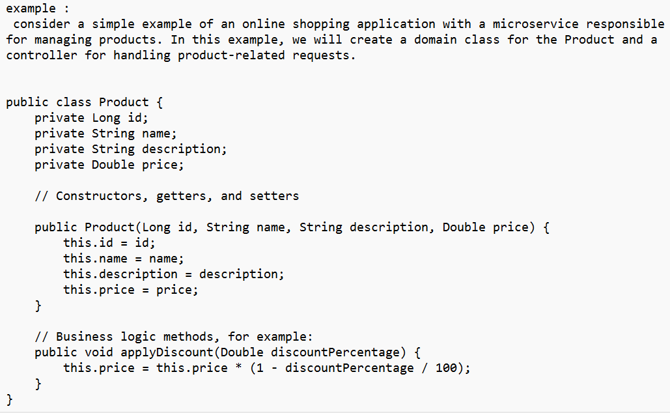

Slide 9
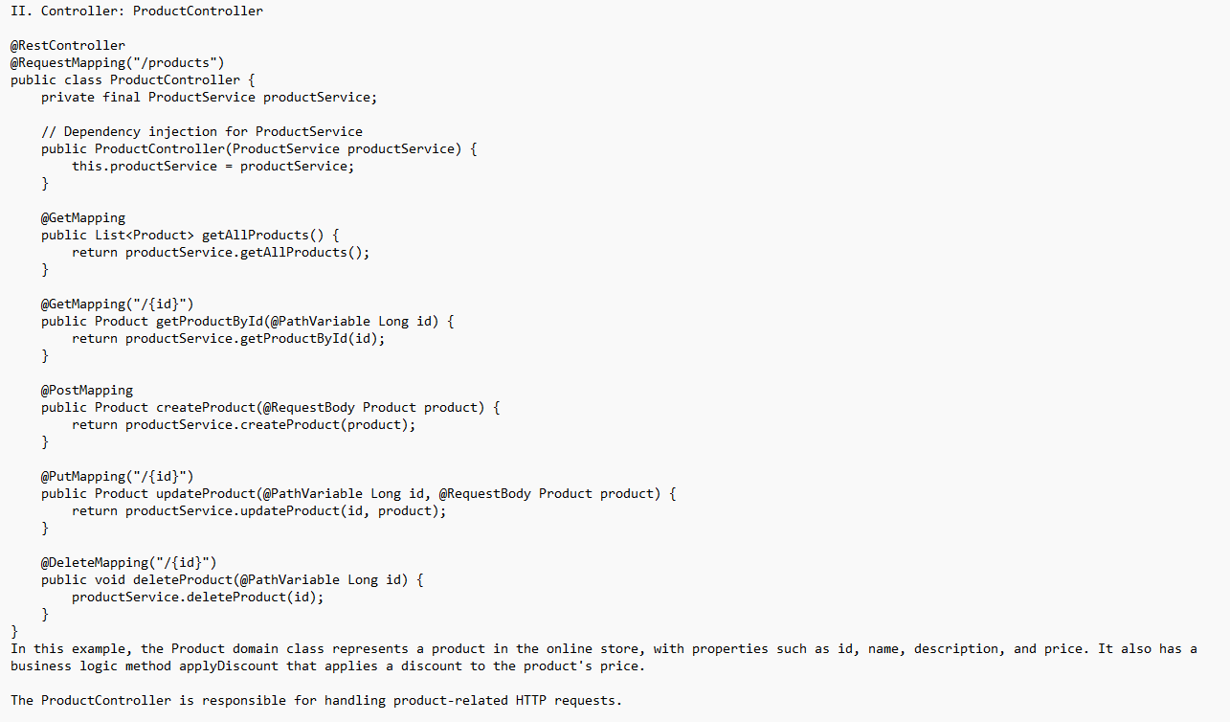

Slide 10
Definition: Repository classes are responsible for managing the data access and storage for domain classes within a microservice. They encapsulate the logic for querying, creating, updating, and deleting domain objects from the underlying data storage system (e.g., databases, file systems, or external APIs) Usage of Repository Classes in Microservice Architecture Separation of Concerns: By using repository classes, microservices can separate the concerns of data access and business logic, leading to cleaner and more maintainable code. This separation allows developers to focus on the core functionality of the microservice without getting entangled in the specifics of data persistence.
Repository classes

Slide 11
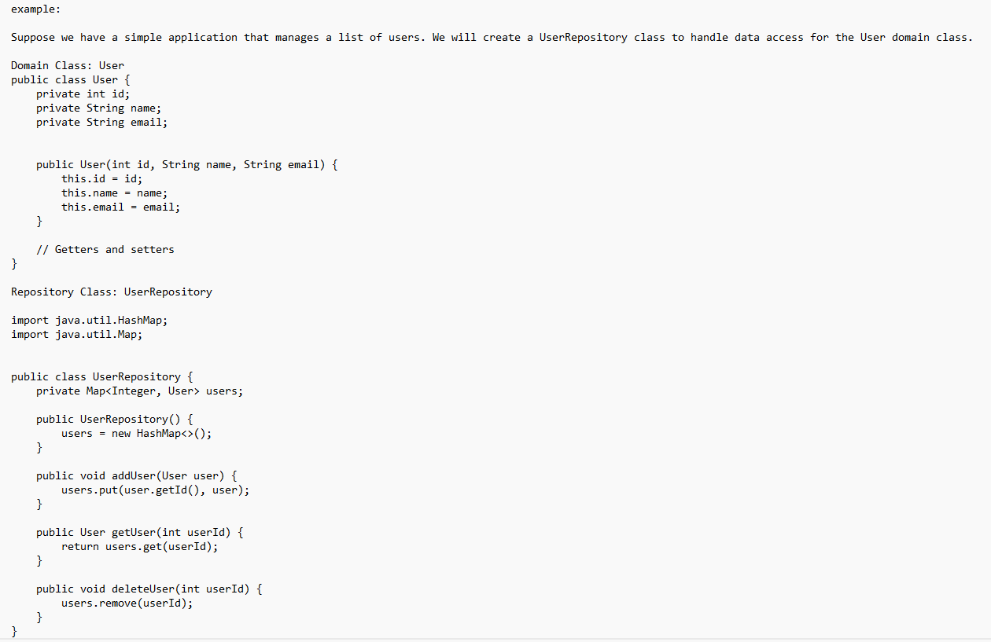

Slide 12
VIEWS
In the context of a backend application (like in Java Spring MVC), the "view" is often represented by data returned from the controller. This data is typically in the form of JSON, XML, or other formats suitable for consumption by frontend or client applications.

Slide 13
controllers handle client requests and orchestrate data flow, while repositories manage data access and storage, ensuring separation of concerns and maintainability in a microservice architecture. By using controllers and repositories effectively, developers can create modular, scalable, and efficient microservices that support the overall goals of the application.
summary

Slide 14
Thank You

